Slide 1
Temporal Convolution Neural Networks (TCN)
By: Suraj RAmchand

Slide 2
Agenda
Introduction
Problems that CNN’s and RNN’s face
TCN’s Basic principles
Background Literature
Success Stories
Deep Dive into TCN’s

Slide 3
Introduction
CNN’s and RNN’s
The Not’ Joke Problems
Facebook* and Google have a problem
*fairseq: A Fast, Extensible Toolkit for Sequence Modeling | DeepAI
Notes:
CNNs can recognize features in static images (or video when considered one frame at a time) while RNNs exceled at text and speech which were recognized as sequence or time-dependent problems. That is where the next predicted character or word or phrase depends on those that came before (left-to-right) introducing the concept of time and therefore sequence
Solving the ‘Not’ Joke Problem
With RNNs reading characters or words from left-to-right in time, context became a problem. For example, in trying to predict the sentiment of a review, the first few comments might be positive (e.g. good food, good atmosphere) but might end with several negative comments (e.g. terrible service, high price) that might ultimately mean the review was negative. This is the logical equivalent of the ‘Not’ joke. ‘That’s a great looking tie. NOT!’.
The solution was to read the text in both directions at once by having two LSTM encoder working at once (bi-directional encoders). This meant having information from the future (further down the text) leaking into the present but it largely solved the problem. Accuracy improved.

Slide 4
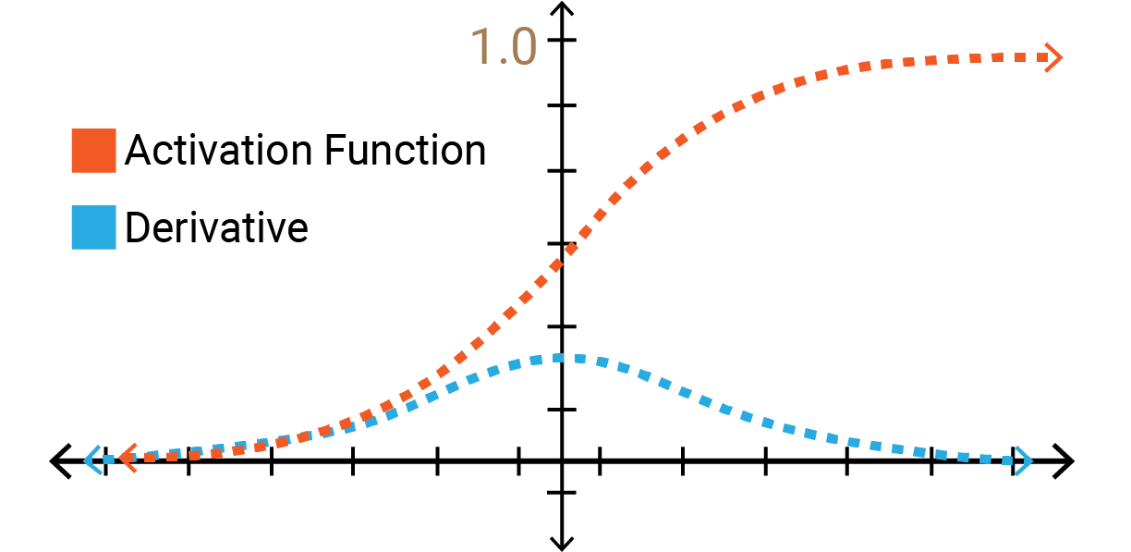
Problems
Non-parallelism -> Longer training times
Memory usage for long sequences.
“Notoriously difficult to train”(Bengio et al. 1994, Pascanu et al. 2013):
Vanishing/exploding gradient
Need for attention mechanism/boosting to remember distant past
CNN in unable to process and learn temporal information.
Notes:
This mostly attributed to RNN’s but the last one mentions a CNN
Facebook and Google Have a Problem
Early on when Facebook and Google were launching their automatic language translators, they realized they had a problem. The translations were taking too long.
RNNs have an inherent design problem. Because they read and interpret the input text one word (or character) at a time, the deep neural network must wait to process the next word until the current word processing is complete.
This means that RNNs cannot take advantage of massive parallel processing (MPP) in the same way the CNNs can. Especially true when the RNN/LSTMs are running both ways at once to better understand context.
It also means they are very compute intensive since all the intermediate results must be stored until the processing of the entire phrase is complete.
In early 2017 both Google and Facebook came to similar solutions, a way to use CNNs with their MPP capability to process text for language-to-language translation. In CNNs the computation doesn’t rely on information from the previous time step, freeing each computation to be conducted separately with massive parallelization.
Google’s solution is called ByteNet, Facebook’s is FairSeq (named after their internal Facebook Artificial Intelligence Research (FAIR) team. FairSeq is available on GitHub.
Facebook says their FairSeq net runs 9X faster than their RNN benchmark.
Vanishing/exploding gradient problem
When training a deep neural network with gradient based learning and backpropagation, we find the partial derivatives by traversing the network from the Faired final layer (y_hat) to the initial layer. Using the chain rule, layers that are deeper into the network go through continuous matrix multiplications in order to compute their derivatives.
In a network of n hidden layers, n derivatives will be multiplied together. If the derivatives are large then the gradient will increase exponentially as we propagate down the model until they eventually explode, and this is what we call the problem of exploding gradient. Alternatively, if the derivatives are small then the gradient will decrease exponentially as we propagate through the model until it eventually vanishes, and this is the vanishing gradient problem.

Slide 5
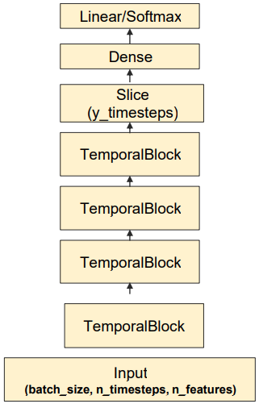
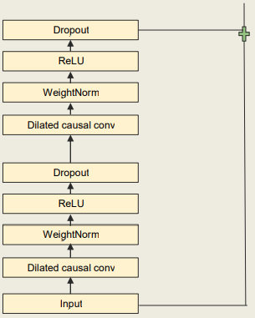
TCN Generic Architecture
Notes:
Thinking about CNNs and how they process images as a 2D ‘patch’ (height and width), making the jump to text requires only that you think of text as a 1D object (1 unit high and n units long).
A TCN, short for Temporal Convolutional Network, consists of dilated, causal 1D convolutional layers with the same input and output lengths.
But while RNNs do not directly predefine object length, CNNs do so by definition. So using CNNs requires us to add more layers until the entire receptive field is covered. This can and does result in very deep CNNs, but with the advantage being, no matter how deep, each can be processed separately in parallel for the huge time savings.

Slide 6

TCN ADVANTAGES/Disadvantages
The convolutions are causal, meaning that there is no information leakage from future to past. (+)
The architecture can take a sequence of any length and map it to an output sequence of the same length just as with an RNN. (+)
TCN’s do not fare well at generalising. (-)
Notes:
To achieve the first point, the TCN uses causal convolutions, i.e., convolutions where an output at time t is convolved only with elements from time t and earlier in the previous layer. To accomplish the second point, the TCN uses a 1D fully-convolutional network architecture, where each hidden layer is the same length as the input layer.
Shaojie Bai, J. Zico Kolter, and Vladlen Koltun also provide this useful list of advantages and disadvantages of TCNs.
Speed is important. Faster networks shorten the feedback cycle. The massive parallelism available with TCNs shortens both training and evaluation cycles.
TCNs offer more flexibility in changing its receptive field size, principally by stacking more convolutional layers, using larger dilation factors, or increasing filter size. This offers better control of the model’s memory size.
TCNs have a backpropagation path different from the temporal direction of the sequence. This avoids the problem of exploding or vanishing gradients which are a major issue with RNNs.
Lower memory requirement for training, especially in the case of long input sequences.
However, the researchers note that TCNs may not be as easy to adapt to transfer learning as regular CNN applications because different domains can have different requirements on the amount of history the model needs in order to predict. Therefore, when transferring a model from a domain where only little memory is needed to a domain where much longer memory is required, the TCN may perform poorly for not having a sufficiently large receptive field.
Extra Info
To accomplish the first point, the TCN uses a 1D fully-convolutional network (FCN) architecture, where each hidden layer is the same length as the input layer, and zero padding of length (kernel size − 1) is added to keep subsequent layers the same length as previous ones. To achieve the second point, the TCN uses causal convolutions, convolutions where an output at time t is convolved only with elements from time t and earlier in the previous layer.
To put it simply: TCN= 1D FCN + causal convolutions
This basic architecture can look back at history with size linear in the depth of the network and the filter size. Hence, capturing long term dependencies becomes really challenging. One simple solution to overcome this problem is to use dilated convolutions.

Slide 7
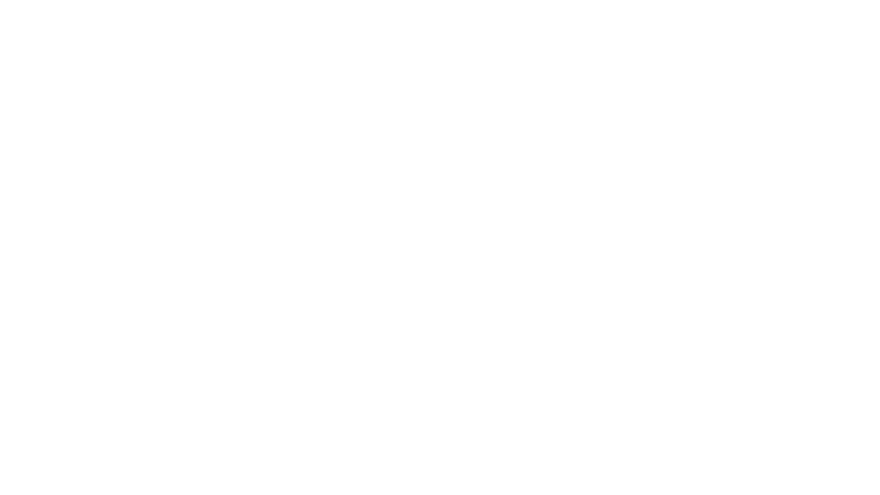
Background literature
Convolutional Networks for sequence modelling is not a new idea. (Hinton and LeCun did it in the 80’s)
CNN’s SoTA on tasks such as:
Audio synthesis(van den Oord et al., 2016)
Word-level language modelling(Kalchbrenner et al., 2016)
Neural machine translation (Dauphin et al., 2017; Gehring et al., 2017a;b)
Speaker recognition (Ravanelli, Bengio, 2018)
When Recurrent Models Don’t Need To Be Recurrent (Miller et al., 2018).
Empirical evaluation of RNN’s vs CNN’s on sequence modelling benchmarks(2018).
Notes:
Hinton and LeCun did it in the 80’s – Where Speech Recgnition was at the forefront of researcher.
WaveNET performs better that other Text to speech networks at its time. Using dilated casual convolutions and skip connections, we will review further today.
Dauphin et al using Convolution and gating to achieve a lower perplexity score than the LSTM approach to model language, using the one billion word google dataset.
By the end pf 2017, both google and facebook had solved their issues with translation by introducing their TCN network. Their study is a series of head-to-head benchmark competitions of TCNs versus RNNs, LSTMs, and GRUs across 11 different industry standard RNN problems well beyond language-to-language translation

Slide 8
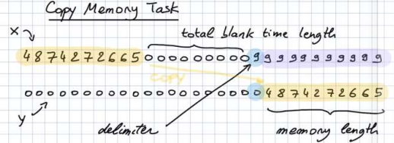
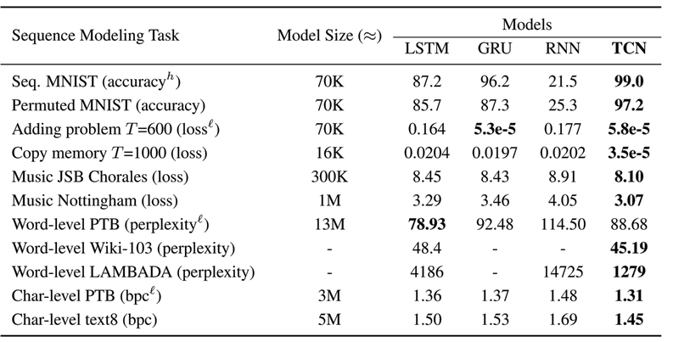
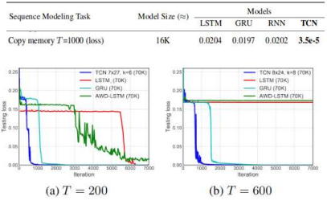
Tests that are performed in paper
Notes:
Sequential MNIST
Time Improvement
Using an Nvidia Titan X, it takes on the order of a minute to train a TCN for each split, whereas it takes on the order of an hour to train an RNN-LSTM. The speedup comes from the fact that we compute one set of convolutions for each layer, whereas RNN-LSTM effectively computes one set of convolutions for each time step.

Slide 9
Deep Dive Into TCN’s

Slide 10
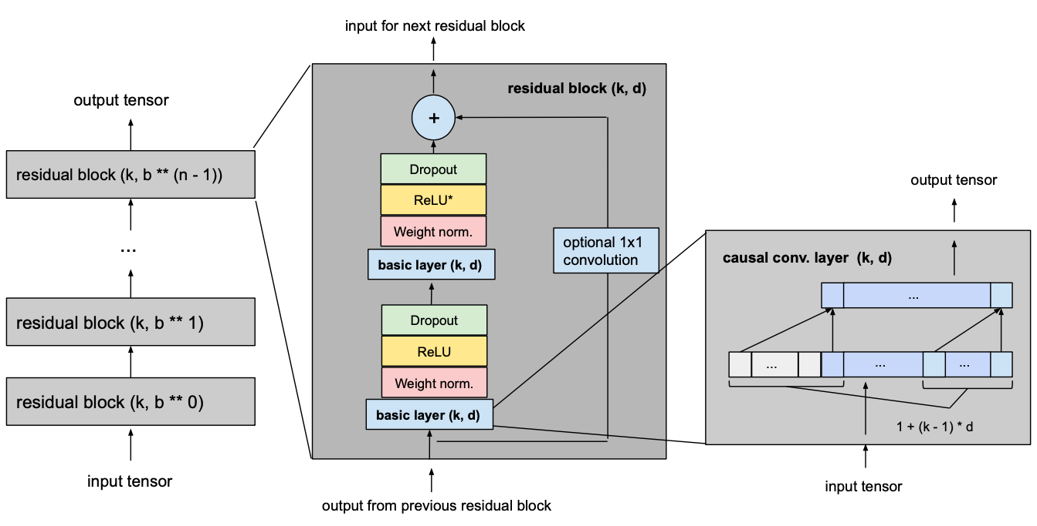
Building Blocks
1D Convolutional Network
Causal Convolution
Dilation
Residual Block
Activation, Normalization, Regularization

Slide 11
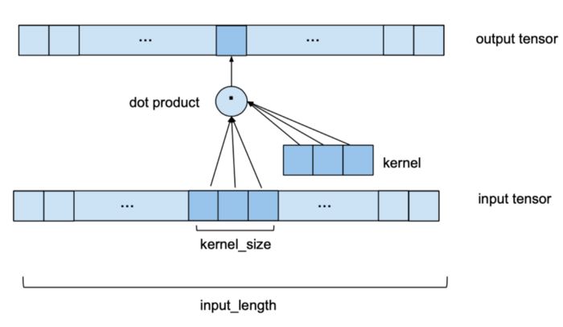
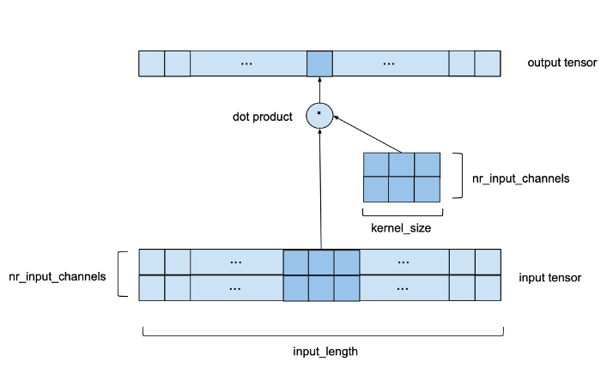
1D Convolutional Network
Input = batch_size, input_length, nr_input_channels/features
Output = batch_size, input_length, nr_output_channels
Notes:
One single 1D convolutional layer receives an input tensor of shape (batch_size, input_length, nr_input_channels) and outputs a tensor of shape (batch_size, input_length, nr_output_channels).
Let’s start with the simplest case where nr_input_channels and nr_output_channels both equal 1. In this case we are looking at 1D input and output tensors. The following image shows how one element of the output tensor is computed. We can see that to compute one element of the output, we look at a series of consecutive elements of length kernel_size of the input. In the above example we chose a kernel_size of 3. To obtain the output, we take the dot product of the subsequence of the input and a kernel vector of learned weights of the same length. To get the next element of the output, the same procedure is applied, but the kernel_size-sized window of the input sequence is shifted to the right by one element (for the purposes of this forecasting model, the stride is always set to 1).
To make sure that the output sequence has the same length as the input sequence, some zero-padding is applied.
A Multivariate scenario, In some sense is equivalent to a 2D convolution with an input tensor of shape (input_size, nr_input_channels) and a kernel of shape (kernel_size, nr_input_channels) as shown in the following image. It’s still 1D in the sense that the window only moves along a single axis, but we do have a 2D convolution at every step in the sense that we are using a 2-dimensional kernel matrix.
For this example we chose nr_input_channels to be equal to 2. Now, instead of a kernel vector sliding over a 1-dimensional input sequence we have a nr_input_channels by kernel_size kernel matrix sliding along a nr_input_channels wide series of length input_length.

Slide 12
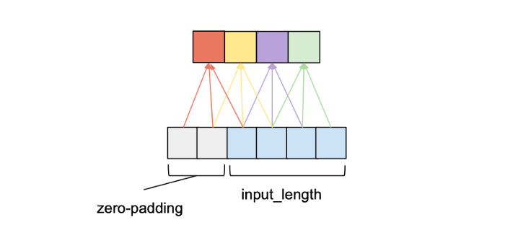
Causal Convolution
For a convolutional layer to be causal, for every i in {0, …, input_length — 1} the i’th element of the output sequence may only depend on the elements of the input sequence with indices {0, …, i}.
Notes:
In other words, an element in the output sequence can only depend on elements that come before it in the input sequence. As mentioned before, to ensure an output tensor has the same length as the input tensor, we need to apply zero padding. If we only apply zero-padding on the left side of the input tensor, then causal convolution will be ensured. To understand this, consider the rightmost output element. Given that there is no padding on the right side of the input sequence, the last element it depends on is the last element of the input. Now consider the second to last output element of the output sequence. Its kernel window is shifted to the left by one compared to the last output element, that means its rightmost dependency in the input sequence is the second to last element of the input sequence. It follows by induction that for every element in the output sequence, its latest dependency in the input sequence has the same index as itself. The following figure shows an example with an input_length of 4 and a kernel_size of 3.
Why is this important…..because of dilation.

Slide 13
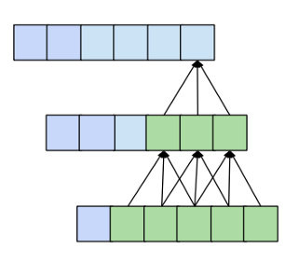
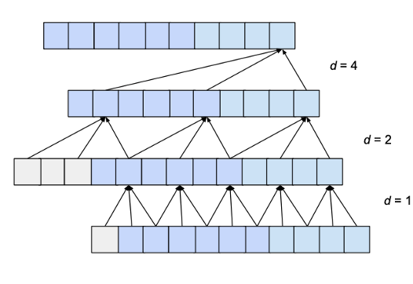

Dilation
Kernel size regulated Time dependence, this is known as the receptive field.
1D convolutional network with n layers and a kernel_size k has a receptive field r of size:
To know how many layers are needed for full coverage, we can set the receptive field size to input_length l and solve for the number of layers n:
Notes:
One desirable quality of a forecasting model is that the value of a specific entry in the output depends on all previous entries in the input, i.e. all entries that have an index smaller or equal to itself. This is achieved when the receptive field, meaning the set of entries of the original input that affect a specific entry of the output, has size input_length. We also call this ‘full history coverage’. As we have seen before, one conventional convolutional layer makes an entry in the output dependent on the kernel_size entries of the input that have an index smaller or equal to itself. For instance, if we have a kernel_size of 3, the 5th element in the output will be dependent on elements 3, 4 and 5 of the input. This reach is expanded when we stack multiple layers on top of each other. In the following figure we can see that by stacking two layers with kernel_size 3 we get a receptive field size of 5.
Dilation in the context of a convolutional layer refers to the distance between the elements of the input sequence that are used to compute one entry of the output sequence. So a conventional convolutional layer could be seen as a 1-dilated layer, since the input elements for 1 output value are adjacent. The following figure shows an example of a 2-dilated layer with an input_length of 4 and a kernel_size of 3.
Reduce Dilation factor on each subsequent layer to increase receptive field of the CNN.

Slide 14
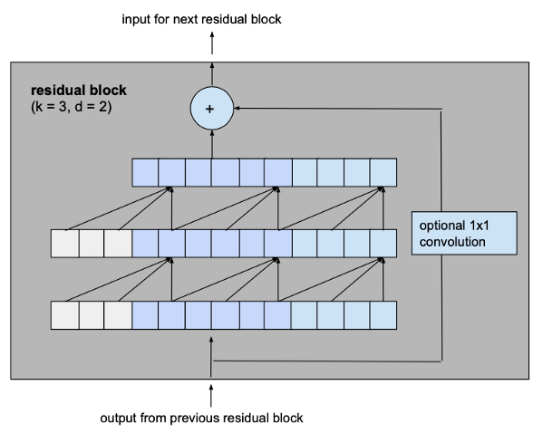


Residual Blocks
Additional Conv Layer and skip connections.
Receptive field increases:
Minimum number of residual blocks n for full history coverage of input_length:
Notes:
The biggest modification we make to the previously introduced basic model is to change the fundamental building block of the model from a simple 1D causal convolutional layer to a residual block which consists of 2 layers with the same dilation factor and a residual connection.
Adding a residual block to a TCN adds twice as much receptive field width than when adding a basic causal layer, since it includes 2 such layers. So the total size of the receptive field r of a TCN with dilation base b, kernel size k with k ≥ b and number of residual blocks n can be computed as.

Slide 15
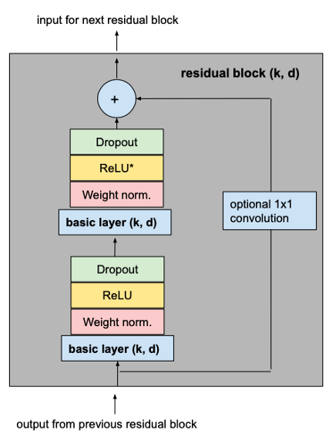
Additional Layers
Activation
Normalization
Regularization
Notes:
To make our TCN more than just an overly complex linear regression model, activation functions need to be added on top of the convolutional layers to introduce non-linearities. ReLU activations are added to the residual blocks after both convolutional layers.
To normalize the input of hidden layers (which counteracts the exploding gradient problem among other things), weight normalization is applied to every convolutional layer.
In order to prevent overfitting, regularization is introduced via dropout after every convolutional layer in every residual block. The following figure shows the final residual block.

Slide 16
Final TCN
Notes:
The following picture shows our final TCN model with l equal to input_length, k equal to kernel_size, b equal to dilation base, k ≥ b and with a minimum number of residual blocks for full history coverage n, where n can be computed from the other values as explained above.

Slide 17
Conclusion
TCN’s are great:
Parallelism
Flexible receptive field size
Low memory requirement for training
Notes:
TCNs can be build to have very long effective history sizes, which means they have the ability to look very far into the past to make a prediction. To this end, a combination of very deep networks augmented with residual layers and dilated convolutions are deployed.
The TCN architecture appears not only to be more accurate than canonical recurrent networks such as LSTMs and GRUs, it also contains the following properties:
Parallelism: Unlike in RNNs where the predictions for later time steps must wait for their predecessors to complete, convolutions can be calculated in parallel because the same filter is used in each layer. Therefore, in both training and evaluation, a long input sequence can be processed as a whole, instead of sequentially as in RNNs.
Flexible receptive field size: The receptive field size can be changed in multiple ways. For instance, stacking more dilated convolutional layers, using larger dilation factors, or increasing the filter size are all viable options. Thus, TCNs afford better control of the model’s memory size, and are easy to adapt to different domains.
Low memory requirement for training: Especially in the case of a long input sequence, LSTMs and GRUs can easily use up a lot of memory to store the partial results for their multiple cell gates. In TCNs, however, the filters are shared across a layer, with the back-propagation path depending only on the network depth.

Slide 18
Questions?

